Slide 1
Business Systems Intelligence
Lecture 5
Data Mining Methodologies

Slide 2
What did we do last time?

Slide 3
Modelling and using the Data Warehouse
Dimensional Modelling (Part 2)
From Star Schema to Snowflakes
Querying and Cubes

Slide 4
The Conversion Process (Summary)
To create the individual ‘stars’ that exist within an application:
Identify the Business Process in the ER model
Look for many-to-many relationships in the ER model containing numeric and additive facts and to designate them as fact tables.
Alternatively, look for ‘events’ or ‘transactions’ – these may also be facts
Denormalize all of the remaining tables into flat tables with single-part keys that connect directly to the fact tables. These tables become the dimension tables.
In cases where a dimension table connects to more than one fact table, we represent this same dimension table in multiple schemas, and we refer to the dimension tables as "conformed" between the dimensional models.

Slide 5
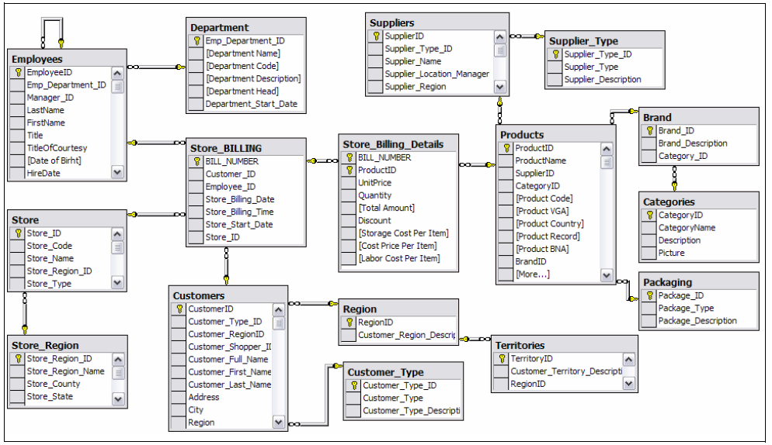
Example ER/DM Conversion

Slide 6
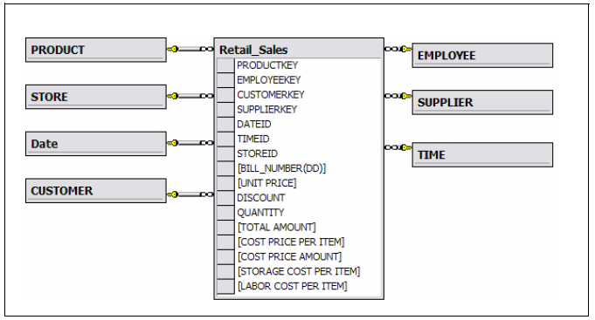
Final Dimensional Model

Slide 7
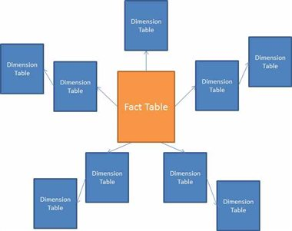
Different Types of Dimensional Model
The star-schema can be extended in a number of ways. The most important of these is the Snow flake model.
Snowflake
Like the Star Schema except that dimensions are normalized to reduce data redundancy

Slide 8
Example Star Schema
time
time_key
day
day_of_the_week
month
quarter
year
item
item_key
item_name
brand
type
supplier_type
Sales Fact Table
time_key
item_key
branch_key
branch
location
location_key
branch_key
branch_name
branch_type
location_key
street
city
state_or_province
country
units_sold
dollars_sold
avg_sales
Measures

Slide 9
Example Snowflake Schema
time
time_key
day
day_of_the_week
month
quarter
year
item
item_key
item_name
brand
type
supplier_key
supplier
Sales Fact Table
supplier_key
supplier_type
time_key
item_key
branch_key
branch
location
location_key
branch_key
branch_name
branch_type
location_key
street
city_key
units_sold
dollars_sold
city
avg_sales
city_key
city
state_or_province
country
Measures

Slide 10
Overview
Data Cubes are an easy way to look at the data (allow us to look at complex data in a simple format).
The cubes provide fast access to pre-computed summarized data, this benefits fast analysis.
Although called a "cube", it can be 2-dimensional, 3-dimensional, or higher-dimensional.

Slide 11
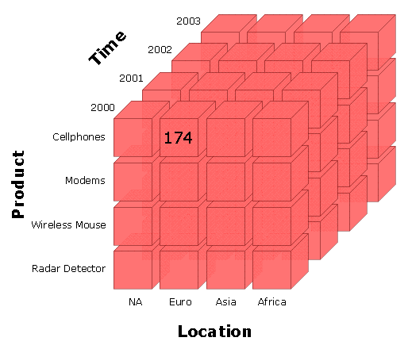
Dimensions and Measures

Slide 12
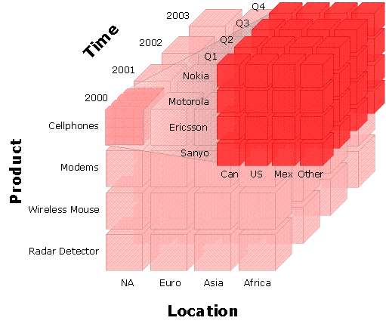
Dicing

Slide 13
Today’s lecture
Today we will look at two methodologies for data mining projects:
CRISP-DM (CRoss-Industry Standard Process for Data Mining)
The SAS SEMMA (Sample, Explore, Modify, Model, Assess) process
We will also consider:
Why do we need a process/methodology?
Which process is better?
What are the other options?

Slide 14
Why do we need a process or methodology?

Slide 15
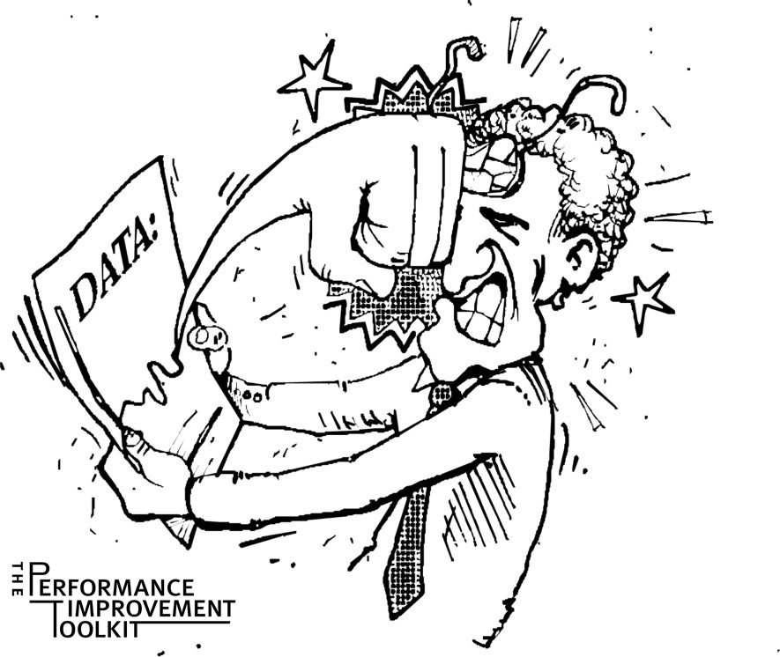
Why do we need a methodology?
Framework for recording experience and allows projects to be replicated
Aid to project planning and management
Comfort factor for new adopters with little data mining background and reduces dependency on “star
performers”.

Slide 16

CRISP-DM
Cross Industry Standard Process for Data Mining

Slide 17



CRISP-DM Evolution
Initiative launched in late 1996 by three “veterans” of the data mining market
Daimler Chrysler (then Daimler-Benz)
SPSS (then ISL)
NCR
Developed and refined through a series of workshops (from 1997-1999)
Over 300 organizations contributed on the process model
Published CRISP-DM 1.0 (1999)
CRISP-DM 1.0 is available at:
http://the-modeling-agency.com/crisp-dm.pdf
Notes:
NCR: National Cash Register. It is an American computer hardware, software and electronics company that makes self-service kiosks, point-of-sale terminals, automated teller machines, check processing systems, barcode scanners, and business consumables.
Daimler manufactures buses and provides financial services through its Daimler Financial Services arm.

Slide 18
CRISP-DM Evolution
Over 200 members of the CRISP-DM SIG worldwide:
DM Vendors: SPSS, IBM, SAS, etc.
System Suppliers/Consultants: Cap Gemini, Deloitte, etc.
End Users: British Telecom, Lloyds Bank, Experian, etc.
Notes:
SPSS predictive analytics software;
Experian: global information services group, headquarters in Dublin. Experian's principal lines of business are credit services, marketing services, decision analytics and consumer services. The company collects information on people, businesses, motor vehicles and insurance. It also collects 'lifestyle' data from on- and off-line surveys.

Slide 19
CRISP-DM
Features of CRISP-DM:
Non-proprietary
Application/Industry neutral
Tool neutral
Focus on business issues
As well as technical analysis
Framework for guidance
Experience-based
Templates for analysis

Slide 20
Hierarchical Process Model
The CRISP-DM data mining methodology is described in terms of a hierarchical process model, consisting of sets of tasks described at four levels of abstraction:
Phase
Generic task
Specialised task
Process instance

Slide 21
Hierarchical Process Model
Phases
Generic Tasks
Specialised Tasks
Process Instances
Notes:
Each phase consists of several generic tasks.
Generic because it is intended to cover all data mining situations, as complete (in process and applications) and stable (models valid for unforeseen situations, like new modeling techniques) as possible.
Specialized tasks is how actions should be carried out in specific situations. For example, “clean the data” described for cleaning numeric values versus cleaning categorical values.
Process instance is a record of the actions, decisions and results of an actual data mining engagement.

Slide 22
Hierarchical Mappings
The key to the CRISP-DM methodology is mapping between the generic and specialised levels
In CRISP-DM there are four different dimensions of data mining contexts distinguished:
The application domain is the specific area in which the data mining project takes place
The data mining problem type describes the specific classes of objectives that the project deals with
The technical aspect covers specific issues in that describe different technical challenges that usually occur
The tool and technique dimension specifies which data mining tool(s) and/or techniques are applied

Slide 23
Data Mining Contexts
 | Data Mining Context
Dimension | Application Domain | Data Mining Problem Type | Technical Aspect | Tools & Techniques
Examples | Response Modelling | Description & Summarisation | Missing Values | Enterprise Miner
 | Churn Prediction | Segmentation | Outliers | Decision Tree
 | … | Concept Description | … | Neural Network
 |  | Classifiction |  | …
 |  | Prediction
 |  | …
Notes:
Response modelling: customer/market response
Customer attrition, also known as customer churn, customer turnover, or customer defection, is the loss of clients or customers.

Slide 24
How To Map?
The basic strategy for mapping the generic process model to the specialized level is:
Analyze your specific context
Remove any details not applicable to your context
Add any details specific to your context
Specialize (or instantiate) generic contents according to concrete characteristics of your context
Possibly rename generic contents to provide more explicit meanings in your context for the sake of clarity

Slide 25
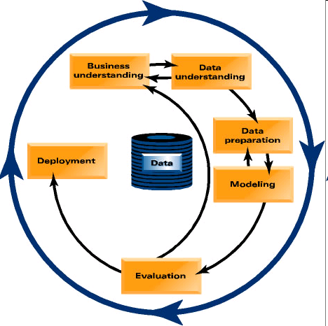
CRISP-DM Phases
Notes:
Idealized sequence of events. In practice, performed in a different order and repeated.

Slide 26
Phases & Generic Tasks
Business
Understanding
Data
Understanding
Data
Preparation
Modeling
Evaluation
Deployment
Determine
Business
Objectives
Business Understanding
This initial phase focuses on understanding the project objectives and requirements from a business perspective, then converting this knowledge into a data mining problem definition and a preliminary plan designed to achieve the objectives
Assess
Situation
Determine
Data Mining
Goals
Produce
Project Plan

Slide 27
Phases & Generic Tasks (cont.)
Business
Understanding
Data
Understanding
Data
Preparation
Modeling
Evaluation
Deployment
Collect
Initial
Data
Data Understanding
The data understanding phase starts with an initial data collection and proceeds with activities in order to get familiar with the data, to identify data quality problems, to discover first insights into the data or to detect interesting subsets to form hypotheses for hidden information.
Describe
Data
Explore
Data
Verify
Data
Quality

Slide 28
Phases & Generic Tasks (cont.)
Business
Understanding
Data
Understanding
Data
Preparation
Modeling
Evaluation
Deployment
Select
Data
Data Preparation
The data preparation phase covers all activities to construct the data that will be fed into the modelling tools from the initial raw data. Data preparation tasks are likely to be performed multiple times and not in any prescribed order. Tasks include table, record and attribute selection as well as transformation and cleaning of data for modelling tools.
Clean
Data
Construct
Data
Integrate
Data
Format
Data
Notes:
Constructive data preparation operations such as the production of derived attributes, entire new records or transformed values for existing attributes.

Slide 29
Phases & Generic Tasks (cont.)
Business
Understanding
Data
Understanding
Data
Preparation
Modeling
Evaluation
Deployment
Select
Modeling
Technique
Modelling
In this phase, various modelling techniques are selected and applied and their parameters are calibrated to optimal values. Typically, there are several techniques for the same data mining problem type. Some techniques have specific requirements on the form of data. Therefore, stepping back to the data preparation phase is often necessary.
Generate
Test Design
Build
Model
Assess
Model

Slide 30
Phases & Generic Tasks (cont.)
Business
Understanding
Data
Understanding
Data
Preparation
Modeling
Evaluation
Deployment
Evaluate
Results
Evaluation
Before proceeding to final deployment of a model, it is important to thoroughly evaluate it and review the steps executed to construct it to be certain it properly achieves the business objectives. A key objective is to determine if there is some important business issue that has not been sufficiently considered. At the end of this phase, a decision on the use of the data mining results should be reached.
Review
Process
Determine
Next Steps

Slide 31
Phases & Generic Tasks (cont.)
Business
Understanding
Data
Understanding
Data
Preparation
Modeling
Evaluation
Deployment
Plan
Deployment
Deployment
Creation of a model is generally not the end of the project. Even if the purpose of the model is to increase knowledge of the data, the knowledge gained will need to be organized and presented in a way that the customer can use it. Depending on the requirements, the deployment phase can be as simple as generating a report or as complex as implementing a repeatable data mining process across the enterprise.
Plan Monitoring
&
Maintenance
Produce
Final
Report
Review
Project

Slide 32
Phase 1: Business Understanding
Statement of Business Objective
Statement of Data Mining Objective
Statement of Success Criteria
Focuses on understanding the project objectives and requirements from a business perspective, then converting this knowledge into a data mining problem definition and a preliminary plan designed to achieve the objectives

Slide 33
Phase 1: Business Understanding (cont.)
Determine business objectives
Thoroughly understand, from a business perspective, what the client really wants to accomplish
Uncover important factors, at the beginning, that can influence the outcome of the project
Neglecting this step is to expend a great deal of effort producing the right answers to the wrong questions
Assess situation
More detailed fact-finding about all of the resources, constraints, assumptions and other factors that should be considered
Flesh out the details

Slide 34
Phase 1: Business Understanding (cont.)
Determine data mining goals
A business goal states objectives in business terminology
A data mining goal states project objectives in technical terms
For example:
Business goal: “Increase catalog sales to existing customers.”
Data mining goal: “Predict how many widgets a customer will buy, given their purchases over the past three years, demographic information (age, salary, city) and the price of the item.”

Slide 35
Phase 1: Business Understanding (cont.)
Produce project plan
Describe the intended plan for achieving the data mining goals and the business goals
The plan should specify the anticipated set of steps to be performed during the rest of the project including an initial selection of tools and techniques

Slide 36
Phase 2: Data Understanding
Explore the Data
Verify Data Quality
Find Outliers
Starts with an initial data collection and proceeds with activities in order to get familiar with the data, to identify data quality problems, to discover first insights into the data or to detect interesting subsets to form hypotheses for hidden information

Slide 37
Phase 2. Data Understanding (cont.)
Collect initial data
Acquire within the project the data listed in the project resources
Includes data loading if necessary for data understanding
Possibly leads to initial data preparation steps
If acquiring multiple data sources, integration is an additional issue, either here or in the later data preparation phase
Describe data
Examine the “gross” or “surface” properties of the acquired data
Report on the results

Slide 38
Phase 2: Data Understanding (cont.)
Explore data
Tackles the data mining questions, which can be addressed using querying, visualization and reporting including:
Distribution of key attributes, results of simple aggregations
Relations between pairs or small numbers of attributes
Properties of significant sub-populations, simple statistical analyses
May address directly the data mining goals
May contribute to or refine the data description and quality reports
May feed into the transformation and other data preparation needed
Verify data quality
Examine the quality of the data, addressing questions such as:
“Is the data complete?”, “Are there missing values in the data?”

Slide 39
Phase 3: Data Preparation
Takes usually over 90% of the time
Collection
Assessment
Consolidation and Cleaning
Covers all activities to construct the final dataset from the initial raw data. Data preparation tasks are likely to be performed multiple times and not in any prescribed order. Tasks include table, record and attribute selection as well as transformation and cleaning of data for modeling tools.
Data selection
Transformations

Slide 40
Phase 3: Data Preparation (cont.)
Select the data
Decide on the data to be used for analysis
Criteria include relevance to the data mining goals, quality and technical constraints such as limits on data volume or data types
Covers selection of attributes as well as selection of records in a table
Clean the data
Raise the data quality to the level required by the selected analysis techniques
May involve selection of clean subsets of the data, the insertion of suitable defaults or more ambitious techniques such as the estimation of missing data by modeling

Slide 41
Phase 3: Data Preparation (cont.)
Construct the data
Constructive data preparation operations such as the production of derived attributes, entire new records or transformed values for existing attributes
Integrate the data
Methods whereby information is combined from multiple tables or records to create new records or values
Format the data
Formatting transformations refer to primarily syntactic modifications made to the data that do not change its meaning, but might be required by the modeling tool

Slide 42
Phase 4: Modeling
Select the modeling technique (based upon the data mining objective)
Build model (parameter settings)
Assess model (rank the models)
Various modeling techniques are selected and applied and their parameters are calibrated to optimal values. Some techniques have specific requirements on the form of data. Therefore, stepping back to the data preparation phase is often necessary.

Slide 43
Phase 4: Modeling (cont.)
Select modeling technique
Select the actual modeling technique that is to be used
For example: decision tree, neural network
If multiple techniques are applied, perform this task for each techniques separately
Generate test design
Before actually building a model, generate a procedure or mechanism to test the model’s quality and validity
Example: in classification, it is common to use error rate as quality measures for data mining models
Therefore, typically separate the dataset into train and test set, build the model on the train set and estimate its quality on the separate test set

Slide 44
Phase 4: Modeling (cont.)
Build model
Run the modeling tool on the prepared dataset to create one or more models
Assess model
Interprets the models according to domain knowledge, the data mining success criteria and the test design
Judges the success of the application of modeling and discovery techniques more technically
Contacts business analysts and domain experts later in order to discuss the data mining results in the business context
Only considers models whereas the evaluation phase also takes into account all other results that were produced in the course of the project

Slide 45
Phase 5: Evaluation
Evaluation of model
How well it performed on test data
Methods and criteria
Depend on model type
Interpretation of model
Important or not, easy or hard depending on algorithm
Thoroughly evaluate the model and review the steps executed to construct the model to be certain it properly achieves the business objectives. A key objective is to determine if there is some important business issue that has not been sufficiently considered. At the end of this phase, a decision on the use of the data mining results should be reached

Slide 46
Phase 5: Evaluation (cont.)
Evaluate results
Assesses the degree to which the model meets the business objectives
Seeks to determine if there is some business reason why this model is deficient
Also assesses other data mining results generated
Unveil additional challenges, information or hints for future directions

Slide 47
Phase 5: Evaluation (cont.)
Review process
Do a more thorough review of the data mining engagement in order to determine if there is any important factor or task that has somehow been overlooked
Review the quality assurance issues
Determine next steps
Decide how to proceed at this stage
Decide whether to finish the project and move on to deployment if appropriate or whether to initiate further iterations or set up new data mining projects
Include analyses of remaining resources and budget that influences the decisions

Slide 48
Phase 6: Deployment
Determine:
How the results need to be utilized?
Who needs to use them?
How often do they need to be used?
Deploy data mining results by:
Scoring a database
Utilizing results as business rules, etc.
Notes:
The deployment can be as simple as generating a report or as complex as implementing a repeatable data mining process across the enterprise.
After a model has been created based on historical data, it can then be applied to new data in order to make predictions, "scoring“. The score, a number between 0 and 1, represents the probability that the customer will indeed switch if they receive a brochure describing the new service in the mail. The scores are placed in a database table, with each record containing the customer ID and that customer's numerical score.

Slide 49
Phase 6: Deployment (cont.)
Plan the deployment
In order to deploy the data mining result(s) into the business, takes the evaluation results and concludes a strategy for deployment
Document the procedure for later deployment
Plan the monitoring and maintenance
Important if the data mining results become part of the day-to-day business and it environment
Helps to avoid unnecessarily long periods of incorrect usage of data mining results
Takes into account the specific type of deployment

Slide 50
Phase 6: Deployment (cont.)
Produce final report
The project leader and his team write up a final report
May be only a summary of the project and its experiences
May be a final and comprehensive presentation of the data mining result(s)
Review project
Assess what went right and what went wrong, what was done well and what needs to be improved

Slide 51
CRISP-DM Outputs
CRISP-DM suggests a comprehensive set of outputs that should result at each phase of the methodology
A full set of document templates are also provided

Slide 52
Why CRISP-DM?
A data mining process must be reliable and repeatable by people with little data mining skills
CRISP-DM provides a uniform framework for
Guidelines
Experience documentation
CRISP-DM is flexible to account for differences
Different business/agency problems
Different data

Slide 53
SEMMA
SAS have their own data mining process known as SEMMA
Sample
Explore
Modify
Model
Assess
Many of the steps in the SEMMA process directly correlate with steps in the CRISP-DM methodology

Slide 54
Why Use SEMMA?
The main reason to consider using the SEMMA process is that the tools created by SAS (e.g. Enterprise Miner) are built around the methodology

Slide 55
Sample
Essentially a data acquisition phase is supported by the following Enterprise Miner nodes:
Input Data
Sample
Data Partition
Time Series

Slide 56
Explore
Similarly to the CRISP-DM, the Data Understanding phase is supported by the following EM nodes:
Variable Selection
Cluster
MultiPlot
StatExplore
Association
Path Analysis

Slide 57
Modify
A data preparation phase similar to that in CRISP-DM is supported by the following EM nodes:
Drop
Transform Variables
Filter
Impute
Principal Components
Notes:
Use the Impute node to replace missing values.
Use the Principal Components node to generate uncorrelated linear combinations of the original input variables and which depend on the covariance matrix or correlation matrix of the input variables. In data mining, principal components are usually used as the new set of input variables for subsequent analysis by modeling nodes.

Slide 58
Model
Regression
Dmine Regression
Decision Tree
Rule Induction
Neural Network
Autoneural
DMNeural
Two-Stage Model
Memory-Based Reasoning
Ensemble

Slide 59
Assess
Similarly to the CRISP-DM, an Evaluation phase is supported by the following EM nodes:
Score
Model Comparison
Segment Profile

Slide 60
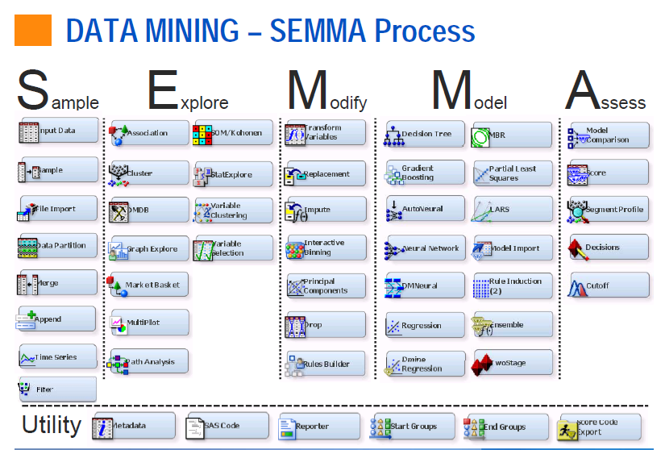
SEMMA Process
More information on Nodes: http://support.sas.com/documentation/cdl/en/emgsj/61207/HTML/default/viewer.htm#n1cpd0rgpneqwqn16mfcxp4sbjsb.htm

Slide 61
SEMMA Wrap-Up
The SEMMA process is similar to the CRISP-DM methodology, although not as detailed
The big advantage of using SEMMA is that it fits neatly with the SAS tools
There are opportunities for using a hybrid of the two processes

Slide 62
Summary
It is important to have structured methodologies for any software project
Data mining is no different
Two particularly interesting options are CRISP-DM and SEMMA
CRISP-DM is particularly detailed and useful
SEMMA is matched clearly by SAS tools

